Slide 1







CCSDPT
Education Sub-Committee
MOI Seminar – 4th April 2019

Slide 2
Teacher & Student Statistics
*9 camps | Students |  | Total
 | M | F
Basic Education | 10,396 | 11,331 | 22,722
ECD - Nursery | 3,560 | 3,416 | 6,976
Special Education | 227 | 183 | 410
TOTAL | 14,183 | 14,930 | 30,108
*9 camps | Teachers |  | Total
 | M | F
Basic Education | 341 | 748 | 1,089
ECD - Nursery | 17 | 423 | 440
Special Education | 0 | 71 | 71
TOTAL | 358 | 1,242 | 1,600

Slide 3
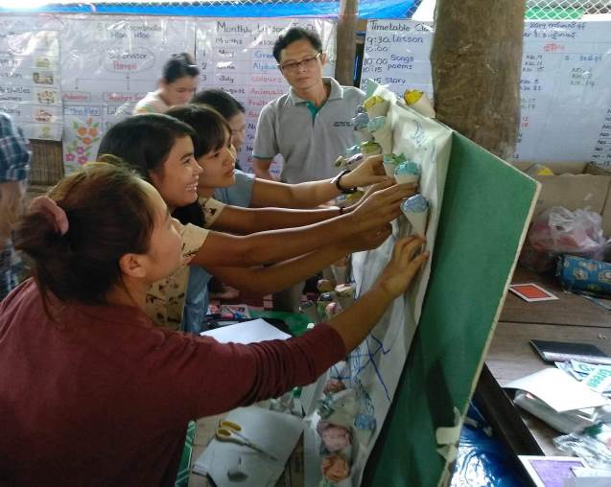
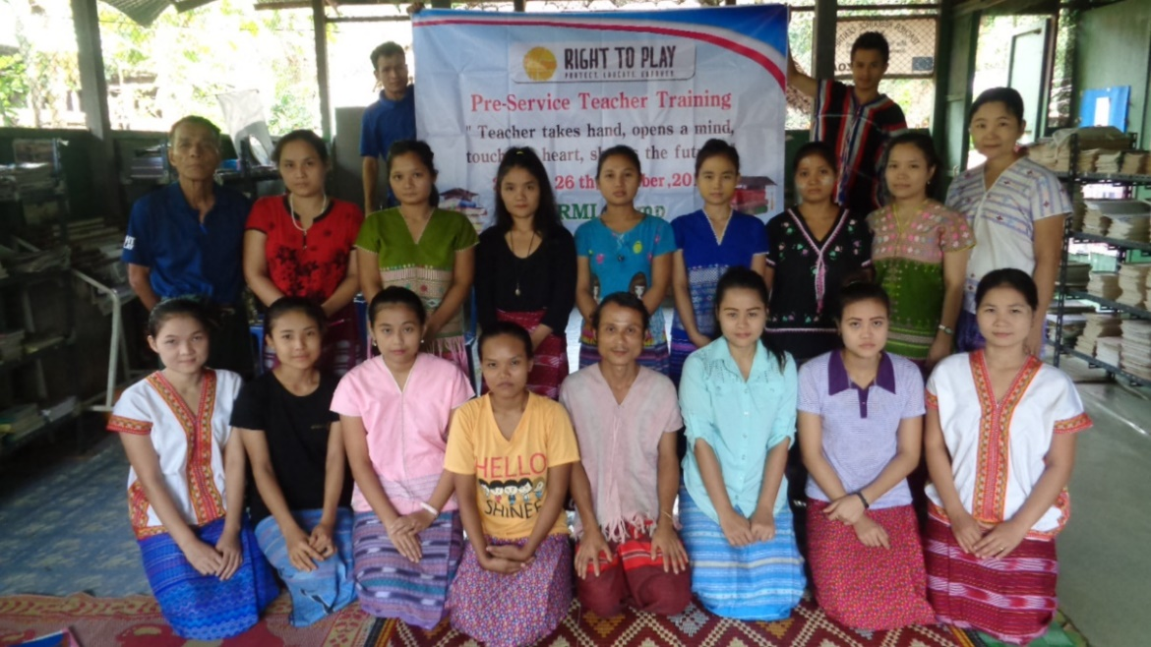

Slide 4
2018 EDUCATION OUTCOMES
853
Teachers Trained
Basic Education
700
Nursery
Teachers Trained
73
School Buildings
Repaired
2,792
Attended
Education Information
Sessions in Prep
for Return
297
Children OOSC
Returned to
Education
564
Teachers Trained
Child Protection
409,488
Library Users
155,971
Books Lent
5,077
Participated in
PTA Meetings
34,600
Mine Risk Education

Slide 5
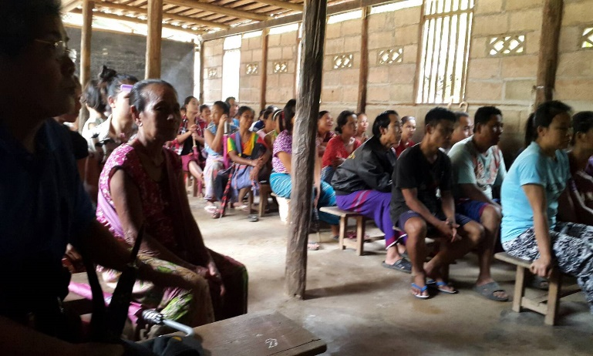
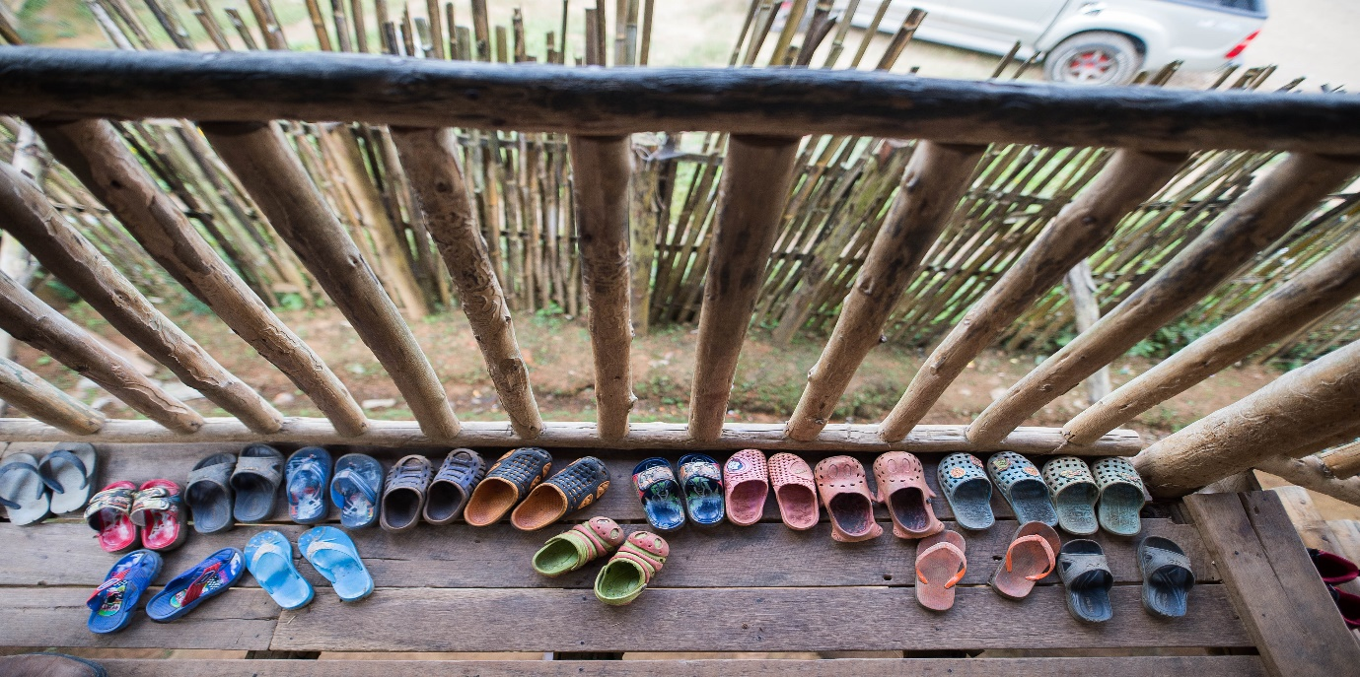
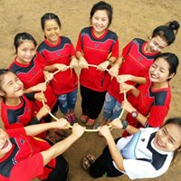
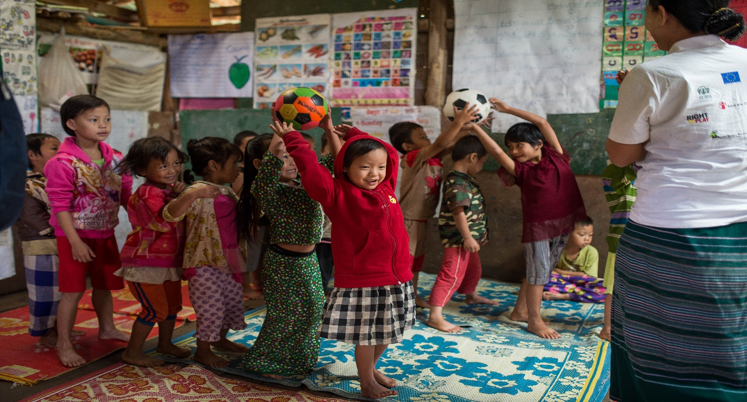

Slide 6
EDUCATION AREAS OF PRIORITY
Children in the 9 temporary shelters along the Thai/Myanmar border continue to have access to quality basic education, including early childhood, primary, secondary and special education, for as long as the camps exist.
Carry out urgent school repairs and refurbishments to ensure a safe and secure learning environment for children and teachers
Continue to develop the capacities and sustainability of CBOs and PTAs to manage and monitor the provision of basic education services with progressively greater independence
  Identify and explore ways to ensure the most efficient use of resources, for example through school consolidation, as well as through the handover, consolidation or streamlining of certain activities (e.g. teacher training, NFL)

Slide 7
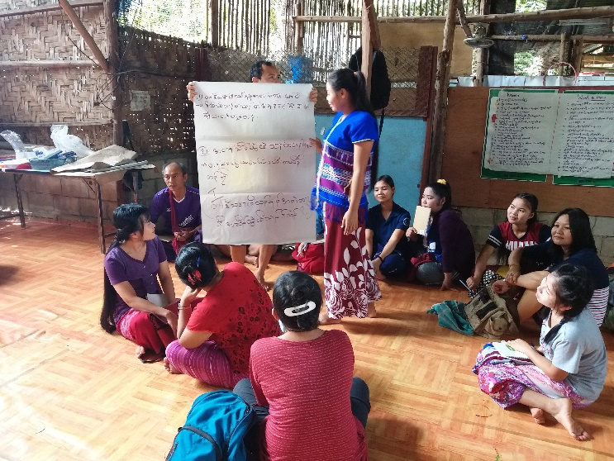
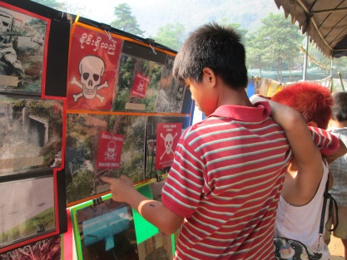

Slide 8
EDUCATION AREAS OF PRIORITY
Refugees are supported in decision-making and preparation for durable solutions and a future outside the camps, including voluntary repatriation to Myanmar
Continue to gather data for teacher recognition and to offer a proof of qualification package to all camp-based education staff
  Continue to strengthen cross-border cooperation and information sharing in order to be able to provide accurate information to refugees about education services available at planned return sites in Myanmar
Coordinate with MOI to ensure access to education for children in 9 refugee camps
Collaborate with MOI to advocate for recognition and integration of student’s learning with the Myanmar Government

Slide 9
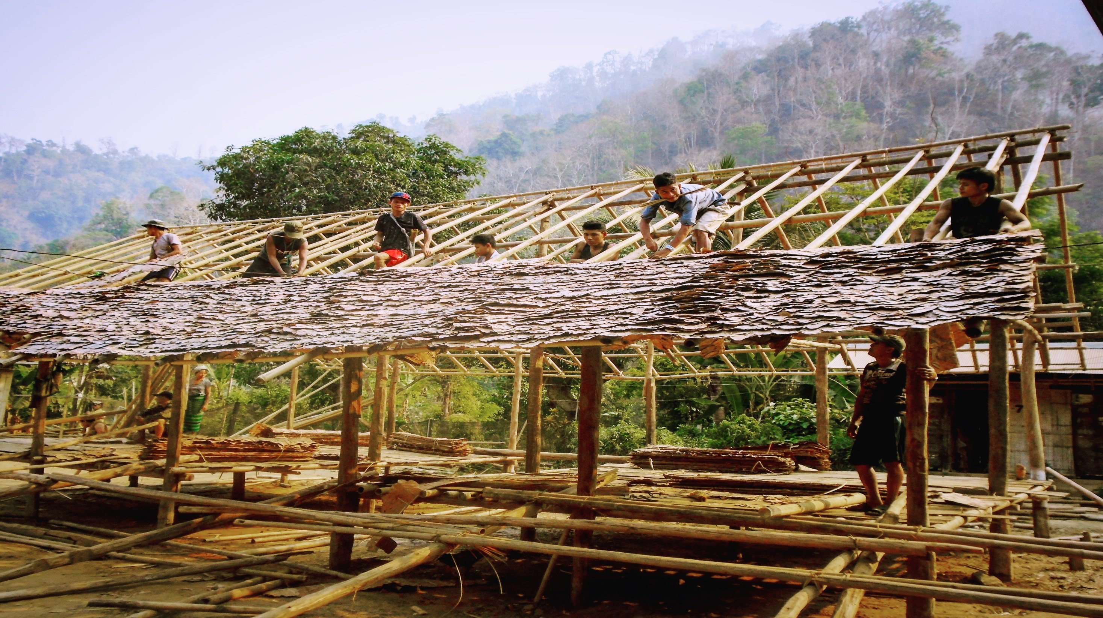

Slide 10
SOLUTION FOCUSED
Challenges
Solutions
Funding gaps across education
Retention of teachers across the education sector
Limited budgets leaving it difficult to maintain good quality implementation of education programming
Maintenance of school structures as safe learning environments
Other
School drop out and OOSC
Students returning under VolRep process are leaving school before their academic year ends
Recognition of Refugee student and teacher learning
Funding gaps
Use the CCSDPT funding tracker to monitor upcoming funding gaps and work with education agencies to source funding.
SVA have started their transition planning downsizing their libraries from 21-15 and handed over the running to the community to ensure sustainability
Consolidation of Basic Education and nursery schools to ensure more cost efficiency.
Other
Identify OOSC and encourage them to return to school or to access alternative pathways to education
Try to schedule returns in May or October to ensure that students can complete their exams and avail of their student transcripts to ensure smoother return to education in Myanmar
Education Stakeholders led by CBOs with NGOs taking a technical role within KKEST (Karen and Karenni Education Stakeholders Team

Slide 11
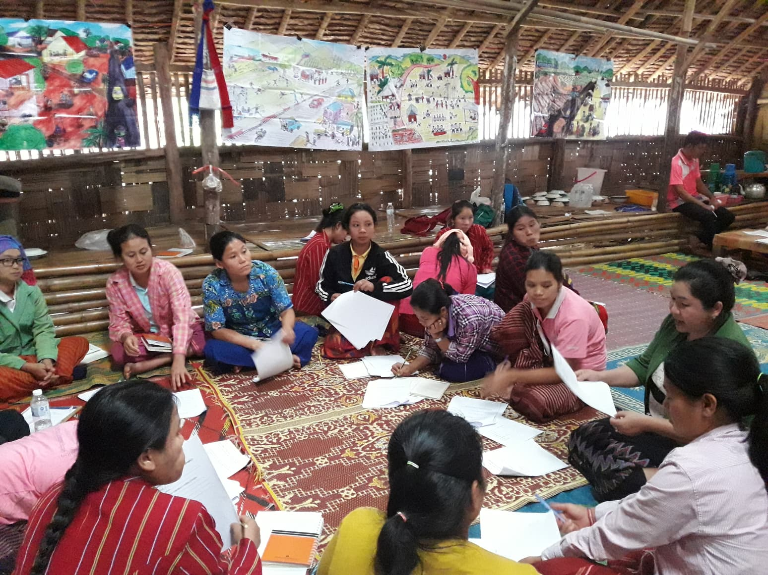
One teacher, one child, one pen, one book can change the world!!

